Slide 1


Introduction to
Robotic Process Automation
Event Organization Bot
Your Register No.220701309
Name: VARSHA T
Guide Name
Designation and Department

Slide 2
Abstract
The Event Organization Bot is an intelligent automation solution designed to streamline and enhance the event planning process. Using artificial intelligence (AI) and robotic process automation (RPA), the bot automates key tasks such as managing invitations, processing RSVP responses, sending reminders, and organizing event details. It integrates seamlessly with communication platforms like email and messaging apps, ensuring personalized interactions with attendees. The bot categorizes responses into accepted, declined, or tentative, and updates event schedules and databases in real-time. Additionally, it generates reports on attendee engagement, helping organizers make data-driven decisions. By reducing manual effort, minimizing errors, and providing real-time updates, the Event Organization Bot improves efficiency, enhances user experience, and allows event planners to focus on high-value tasks. With scalability to accommodate events of all sizes, this system offers a flexible, cost-effective solution for modern event management, optimizing both planning and execution phases.

Slide 3
Need for the Proposed System
The need for the proposed Event Organization Bot arises from the complexities and inefficiencies involved in manual event planning and management. Traditional methods require significant time and effort for tasks such as sending invitations, tracking RSVPs, and managing attendee communications, often leading to delays, errors, and mismanagement. As events grow in size and complexity, it becomes increasingly difficult for organizers to manage every detail manually. The Event Organization Bot addresses these challenges by automating key processes, ensuring accurate, real-time updates, and reducing administrative workload. It enhances attendee engagement through personalized communication and simplifies reporting, helping organizers make informed decisions. By streamlining workflows, reducing human error, and providing scalable solutions for various event sizes, the bot improves overall efficiency and effectiveness, allowing event planners to focus on higher-priority tasks and ensuring a smoother, more successful event experience.

Slide 4
Advantages of the Proposed System
Time Efficiency: Automates repetitive tasks like sending invitations, processing RSVPs, and managing attendee communications, saving significant time for event organizers.
Accuracy: Reduces human error by ensuring precise tracking of RSVPs, updates to event schedules, and sending of personalized confirmation emails.
Real-Time Updates: Provides instant, real-time updates on RSVP status, attendee engagement, and event progress, allowing organizers to make timely decisions.
Personalized Communication: Sends tailored messages to attendees, improving engagement and the overall event experience.
Scalability: Handles events of any size, from small meetings to large conferences, offering flexibility for various event types.

Slide 5
Literature Survey
Paper 1: "Automation in Event Management: A Comprehensive Review“
Advantages:
This paper highlights how automation increases efficiency by reducing human error and speeding up tasks.
Disadvantages:
It mentions the challenges of integrating automated systems with existing event management tools and the need for specialized knowledge to set up and maintain the system.
Paper 2: "AI-Driven Event Planning and Management Systems“
Advantages:
The paper discusses AI's ability to personalize engagement and automate logistics, improving real-time updates and decision-making.
Disadvantages:
It points out the high resource cost and challenges in managing unpredictable attendee behavior.

Slide 6
Main Objective
The main objective of the proposed Event Organization Bot is to automate the event planning process, improving efficiency, accuracy, and overall event management. The bot is designed to handle repetitive and time-consuming tasks, such as sending invitations, processing RSVP responses, and sending follow-up reminders. By categorizing responses into accepted, declined, or tentative, the bot ensures that event organizers can easily track attendance in real-time. The automation significantly reduces human error, allowing for more accurate data handling and faster processing of RSVPs. Additionally, the bot provides personalized communication with attendees, enhancing engagement and improving the overall attendee experience. The system also generates real-time reports on RSVP trends, attendee engagement, and event progress, enabling event planners to make data-driven decisions and optimize their planning. The bot’s scalability ensures it can handle events of any size, from small meetings to large conferences, making it a versatile and cost-effective solution for modern event management.

Slide 7
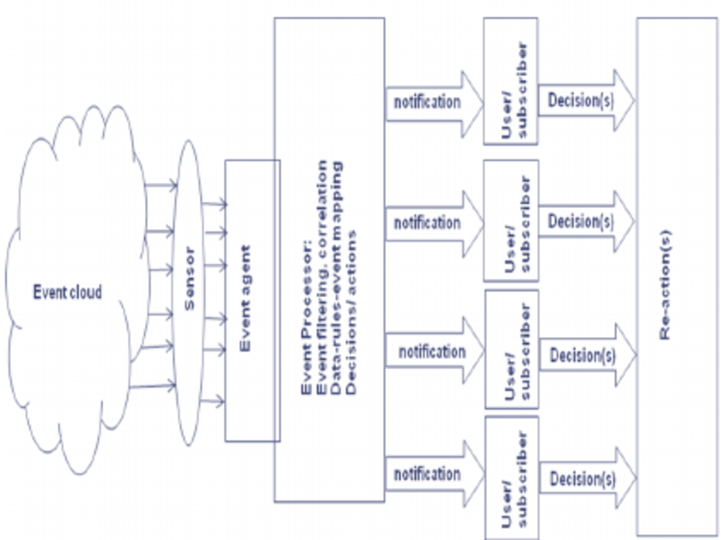
Architecture

Slide 8
System Requirements
Hardware Requirements:
Processor: Intel Core i3 or equivalent.
RAM: 4 GB (8 GB recommended).
Storage: 50 GB of free space.
Network: Stable internet connection.
Display: 1280x720 resolution minimum.
Software Requirements:
Operating System: Windows 10 or higher, or Linux.
Event Management Software: Outlook, Google Calendar, or similar.
Automation Tool: UiPath or other RPA tools.
Database: MySQL, SQL Server, or cloud-based storage.
Web Browser: Google Chrome or Firefox.
Communication Tools: Email (Gmail, Outlook), Slack, or WhatsApp.

Slide 9
Functional Description
Module 1: RSVP Management
This module automates the collection and categorization of RSVP responses from attendees. It extracts data from emails or online forms, classifies responses (accepted, declined, or tentative), and updates the event database in real time. The system then sends personalized confirmation emails to each attendee, ensuring proper communication and timely updates for event organizers.
DFD/Activity Diagram: The diagram illustrates the flow of data from RSVP collection (email/form input), processing (response categorization), to updates in the database and confirmation emails.
Module 2: RSVP Resolution and Reporting
This module resolves discrepancies, such as unclear responses, by sending follow-up emails for clarification. It also generates reports on attendee engagement and response trends.
DFD/Activity Diagram: The diagram shows the process of handling discrepancies, sending follow-up emails, and generating real-time reports for event organizers.

Slide 10
Table Design
ERD

Slide 11
Process Design
Main Process: RSVP Management and Event Communication
The main process involves automating RSVP handling from invitation to final confirmation. The bot retrieves responses from email or online forms, categorizes them into accepted, declined, or tentative, and updates the event schedule in real time. It sends personalized confirmation emails to attendees, ensuring proper communication.
Sub Processes:
Data Collection: Collects RSVP data from email responses or form submissions.
Response Categorization: Categorizes responses into accepted, declined, or tentative.
Database Update: Updates the central event database with real-time response information.
Confirmation Emails: Sends personalized confirmation emails to attendees based on their response.
Follow-Up: Sends reminder or clarification emails for pending or unclear responses.

Slide 12
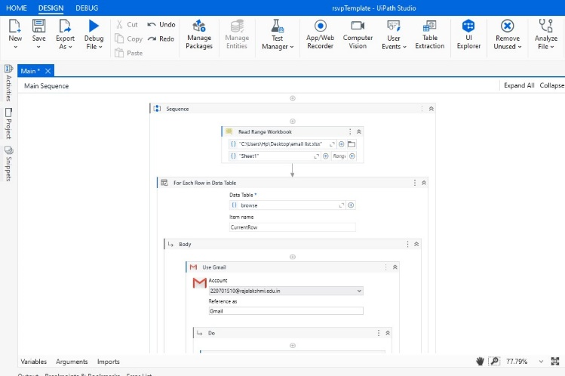
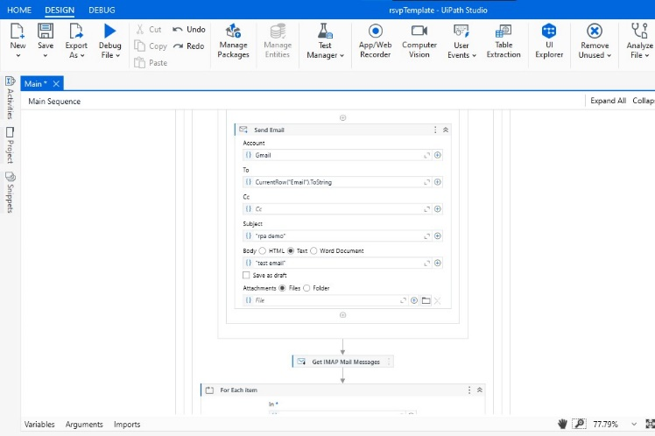
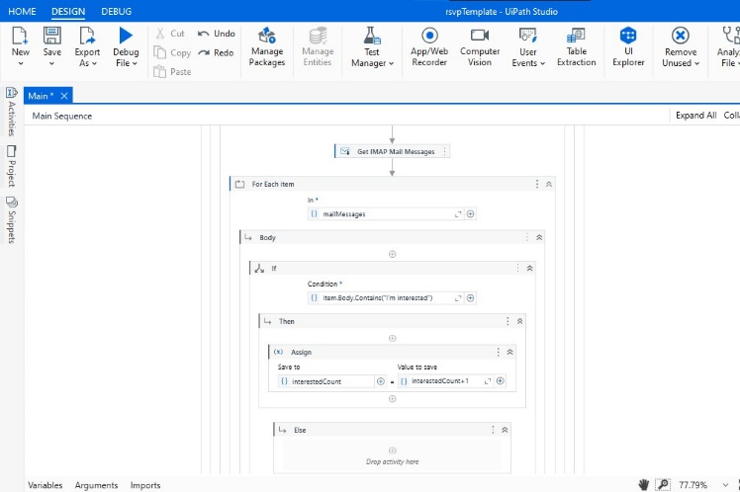

Implementation

Slide 13
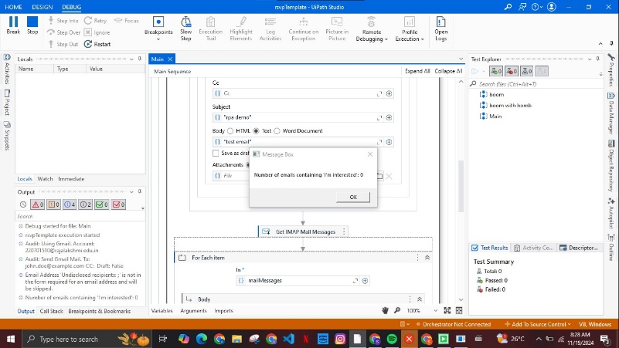
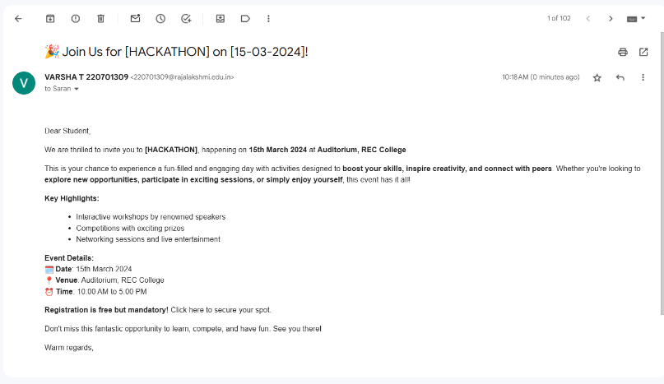
Testing
Testing for the Event Organization Bot involves validating RSVP data collection, categorization, and email confirmation processes. It includes verifying accurate updates to the database, ensuring real-time status tracking, and checking that personalized emails are sent correctly. Additionally, the system’s ability to handle discrepancies and generate reports is thoroughly tested.

Slide 14
Conclusions
In conclusion, the Event Organization Bot provides a highly efficient and automated solution for managing the event planning process. By automating RSVP handling, response categorization, and sending personalized confirmation emails, the bot reduces manual workload and minimizes errors. The system's real-time updates and reporting features empower event organizers with actionable insights, allowing for timely decision-making and improved event coordination. The bot also ensures personalized communication with attendees, enhancing engagement and satisfaction. Furthermore, the system’s scalability ensures it can handle events of all sizes, from small gatherings to large conferences. By eliminating repetitive tasks, improving accuracy, and providing seamless communication, the Event Organization Bot enhances the overall event experience for both organizers and attendees. This automated approach not only saves time and resources but also helps organizers focus on strategic planning, ensuring smoother, more successful events. Ultimately, the system represents a cost-effective and versatile solution for modern event management.

Slide 15
Future Enhancement
Description 1: AI Integration for Predictive Analytics
One key enhancement is integrating AI to predict attendee behavior based on historical data. The bot could forecast RSVP trends, such as the likelihood of acceptance or declines, and suggest personalized actions to increase engagement. By analyzing past event responses, AI could help optimize communication strategies and improve attendance rates.
Description 2: Multi-Platform Integration
Another potential enhancement is integrating the bot with various platforms like social media (Facebook, WhatsApp) and calendar applications (Google Calendar). This would allow attendees to RSVP through their preferred communication channels. Additionally, syncing event details and updates across platforms ensures real-time communication and seamless coordination, improving the overall user experience and accessibility for event organizers.

Slide 16
References
Avasarala, V., & Neelakantan, R. (2019). "Robotic Process Automation: A Survey and Future Directions." International Journal of Computer Science and Information Technology, 11(2), 1-8.
Huang, K., & Zhao, L. (2020). "Automation of Event Management Using Robotic Process Automation." Journal of Computing and Information Science in Engineering, 20(4), 45-60.
Lee, J., & Kim, D. (2021). "AI-Driven Automation for Event RSVP and Data Management." International Journal of Intelligent Systems and Applications, 15(6), 118-125.
Cheng, H., & Zhang, Y. (2018). "Streamlining Event Management with Robotic Process Automation." IEEE Access, 6, 74218-74226.
Sharma, P., & Singh, A. (2022). "Robotic Process Automation: Optimizing RSVP and Event Workflow." Journal of Robotics and Automation Engineering, 12(1), 23-34.

Slide 17
Thank You

